Slide 1
Division of Developmental Disabilities August 5, 2021

Slide 2
Agenda
Introduction
COVID-19 Updates
Announcements
Nursing Assessment Tool
Susan Rotundo, DDD Project Management Office
COVID-19 Vaccines & Vaccine Hesitancy
Dr. Len Branham, DDD Pharmacy Director
Notes:
LEAH:

Slide 3
COVID-19
DDD’s top priority is the health and safety of our members, their families, and the professionals in our program that support them
The Division of Developmental Disabilities (DDD) is:
Working with ADHS and CDC guidelines to ensure appropriate measures are in place to allow for the continuation of necessary services
Monitoring service delivery and availability to ensure service continuation
Providing regular updates on the DDD COVID-19 Website: https://bit.ly/DDD_COVID19Actions
Notes:
LEAH:
The COVID-19 pandemic has now been impacting Arizona for over 16 months. The health and safety of members, their families and the professionals who support them continues to be DDD’s top priority.
We continue to monitor the Centers for Disease Control and Prevention and Arizona Department of Health Services for new guidelines and are updating our guidance accordingly to ensure compliance.
We are monitoring service delivery and availability to ensure members are able to receive the services they need.
We are continually updating the DDD Actions Related to COVID-19 webpage as new information becomes available.

Slide 4
COVID-19 Updates
AHCCCS COVID Flexibilities
Flexibilities Ending Prior to the Conclusion of the PHE
Effective July 1, 2021 - All Direct Care Workers will once again be required to complete their training requirements within 90-days of being hired.
Effective October 1, 2021 - Annual limit of respite hours will return to 600 hours per contract year.
Flexibilities Ending Upon Conclusion of the PHE
Virtual case management (support coordination) visits for ALTCS members.
Reimbursement for parents offering direct care to minor children.
Virtual supervisory visits of Direct Care Workers.
Home delivered meals.
Notes:
LEAH:
The COVID-19 public health emergency (PHE) has changed the way DDD and other Managed Care Organizations in Arizona support individuals who receive Medicaid benefits in Arizona.
Many of these changes were implemented by AHCCCS with approval from the Centers for Medicare and Medicaid Services (CMS) in order to ensure individuals were still able to receive services while protecting the health and safety of the professionals providing those services. DDD has referred to these authorized changes as “flexibilities” since they were implemented as they allowed our program to be flexible in how services are provided.
Since the beginning of the Public Health Emergency, these flexibilities were understood to be temporary and would eventually be “unwound.” AHCCCS worked with CMS to tie the flexibilities to the end of the PHE.
AHCCCS has recently announced changes that will impact DDD members and the professionals who support them.
Some of the announced changes will end prior to the conclusion of the public health emergency while some will end when the public health emergency ends.
First, the two flexibilities scheduled to end before the public health emergency include the requirement that all Direct Care Workers complete their required training within the first 90-days of their employment. This requirement goes back into effect on July 1, 2021. The second flexibility that will change before the end of the public health emergency is the number of respite hours. During the public health emergency the respite hour limit was increased to 720 hours for the year. Effective October 1, 2021, the limit will return to the pre-pandemic limit of 600 hours per contract year.
AHCCCS has also announced some changes that will end with the conclusion of the public health emergency. These include:
Virtual case management visits for ALTCS members. These are the quarterly planning meetings that we have been doing virtually during the public health emergency. DDD is still considering when to resume in-person planning meetings and what if any changes will be made. More information will be communicated as those decisions are made.
Parents as paid providers of direct care to their minor children (will discuss more in this presentation)
Qualified vendors will return to in-person supervisory visits with direct care workers rather than virtual supervisory visits.
Home delivered meals will no longer be available.
AHCCCS is still reviewing additional flexibilities and will provide more information when they make additional changes which the Division will communicate.

Slide 5
COVID-19 Updates
AHCCCS COVID Flexibilities
Direct Care Worker Training Requirements
Effective July 1, 2021, all Direct Care Workers will be required to complete their training requirements within 90 days of their hire date. This means all agency employees providing Attendant Care services (ATC) or Housekeeping (HSK) must complete the mandatory Direct Care Worker training, including parents providing these services to their minor children.
The target date for completion is September 30, 2021.
Qualified Vendors that believe they will be unable to comply by this date may submit a compliance plan to the Division no later than August 30, 2021, documenting their plan to bring their employees into compliance and the anticipated date of compliance.
Questions about this requirement and compliance plans should be submitted via email to
DDDHCBS@azdes.gov.
Notes:
LEAH: Work with your Agency to ensure you have access to all training and materials.

Slide 6
COVID-19 Updates
AHCCCS American Rescue Plan Act (ARPA) of 2021
Parents as Paid Caregivers
AHCCCS has requested this as a time-limited service through March 31, 2024, to help prevent gaps in care due to current challenges associated with DCW recruitment and retention
Parents will be required to:
Be employed by an Attendant Care agency (Qualified Vendor Agency)
Meet all requirements for employment
Comply with Electronic Visit Verification (EVV) requirements
To read the complete AHCCCS ARPA Proposal: https://bit.ly/ahcccsarpaplan
Notes:
As part of the its ARPA Proposal, AHCCCS has requested adding Parents and Paid Providers Providers for the Minor Children to continue through March 2024.
AHCCCS has submitted additional requests in it’s ARPA Proposal to include additional training and support opportunities for families.
Full ARPA Proposal Language:
In response to extensive stakeholder feedback and observations made throughout the COVID-19 Public Health Emergency (PHE), AHCCCS has identified several ways that members in Arizona can be better served through engagement and formal supports from their parents. The following proposals describe
strategies that aim to strengthen or enhance current HCBS services.
Parents as Paid Caregivers
As a time-limited solution to address concerns regarding the Direct Care Worker (DCW) workforce shortage, AHCCCS seeks approval to allow parents to serve as paid caregivers of their minor children who are enrolled in ALTCS. AHCCCS currently has Appendix K authority to pay parents for providing care to their minor children during the PHE. AHCCCS proposes to continue this allowance following the termination of the PHE as the agency works in partnership with MCOs, providers and community stakeholders to build a robust DCW workforce, employing several of the proposals outlined in this plan. Of note, this was the number one recommendation from community stakeholders in regard to the reinvestment of ARPA funds. This allowance, extending temporarily through March 31, 2024, will support MCOs in maintaining appropriate and timely access to care. It is anticipated that the removal of this allowance at the end of the PHE would otherwise result in gaps in care due to current challenges associated with DCW recruitment and retention. Under the proposal, parents will be required to be employed by an Attendant Care agency and will be required to meet all provider-specific and AHCCCS-specific criteria for employment including passing standardized DCW competency tests. Additionally, parents will have to comply with electronic visit verification (EVV) requirements to track service delivery and prevent and detect fraud, waste and abuse.
Parent University
AHCCCS is proposing a parent and provider training program that would focus on everything from parenting basics (i.e., infant CPR) to stress associated within parenting roles, including for parents whose children are in the custody of the Department of Child Safety. The intent is to make the parenting program available to parents/guardians of children of all ages with a focus on supporting children in the home setting and meeting their specific needs. The curriculum content will be applicable to anyone who is a caregiver or parent of a child regardless of the child’s level of need. Funding will be used to assist providers in developing a tool and/or assessment process for determining the needs of the family, especially for those who may access or currently access behavioral health
services. Courses will be developed from existing AHCCCS trainings (e.g., Back to Basics training for maternal/child health and children’s system of care) as well as national best practices and evidence based curriculum. Additionally, the funding will be used to cover supportive services such as adapting
curriculum to online learning modalities.
Outcomes for the training programs will be specific to member/family treatment plans and goals. To date, two specific parenting programs have been identified for this initiative; both are in alignment with AHCCCS’ System of Care model (e.g., utilizing strength-based and evidenced-based programs) which covers all age ranges and developmental milestones. AHCCCS is interested in the following programs:
Triple P: An evidence-based parenting program with five levels of focus, ranging from basic to intensive skill levels. The highest level addresses parenting a child or adolescent with behavioral needs (e.g., relationship conflict, depression, etc.) or parents at risk of maltreating children. This program also features a track for parents with children with disabilities or at risk for disabilities. Triple P is available in 10+ languages and can be modified to meet cultural needs and norms of the participants.
Strengthening Families: A targeted program focused on the development of family skills over a 14-week period. Parenting material covers children ages 3-5, 6-11, and 12-16. The primary program focus is to help parents set appropriate expectations for their child’s behavior (based on developmental level and age), build positive relationships, and implement positive reinforcement as well as appropriate consequences for the child’s behaviors. This program is also available in multiple languages and is targeted for parents of children with complex behaviors and providing supports to successfully maintain the child in their home environment.

Slide 7
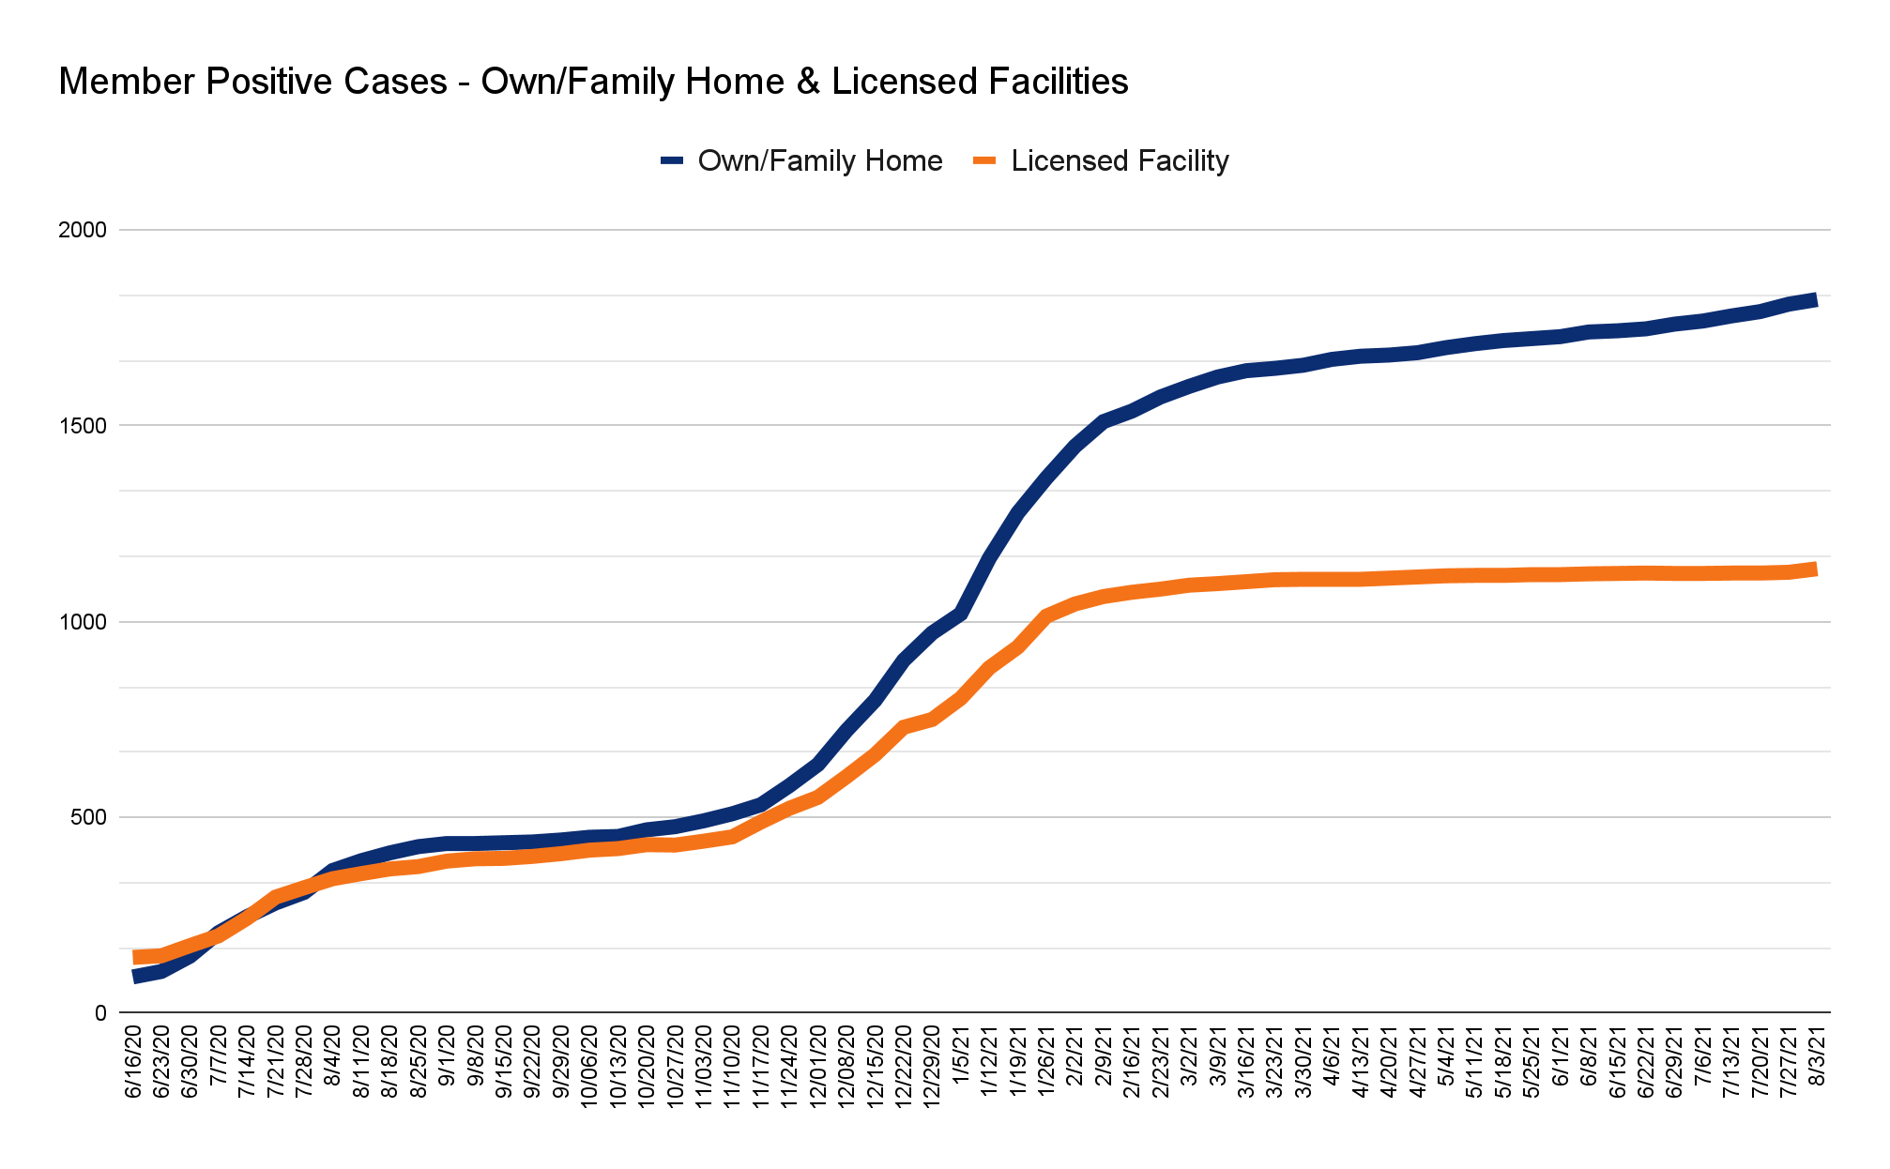
COVID-19 Member Positive Tests
Notes:
NICOLETTE:
As of July 1, 2021: Total DDD Members: 45,726
Total DDD Members in Own/Family Home: 40,662
Total DDD Members in Licensed Facility: 5,064
Total Positive Cases: 2,958
Own Home: 1,823
Licensed Facility: 1,135

Slide 8
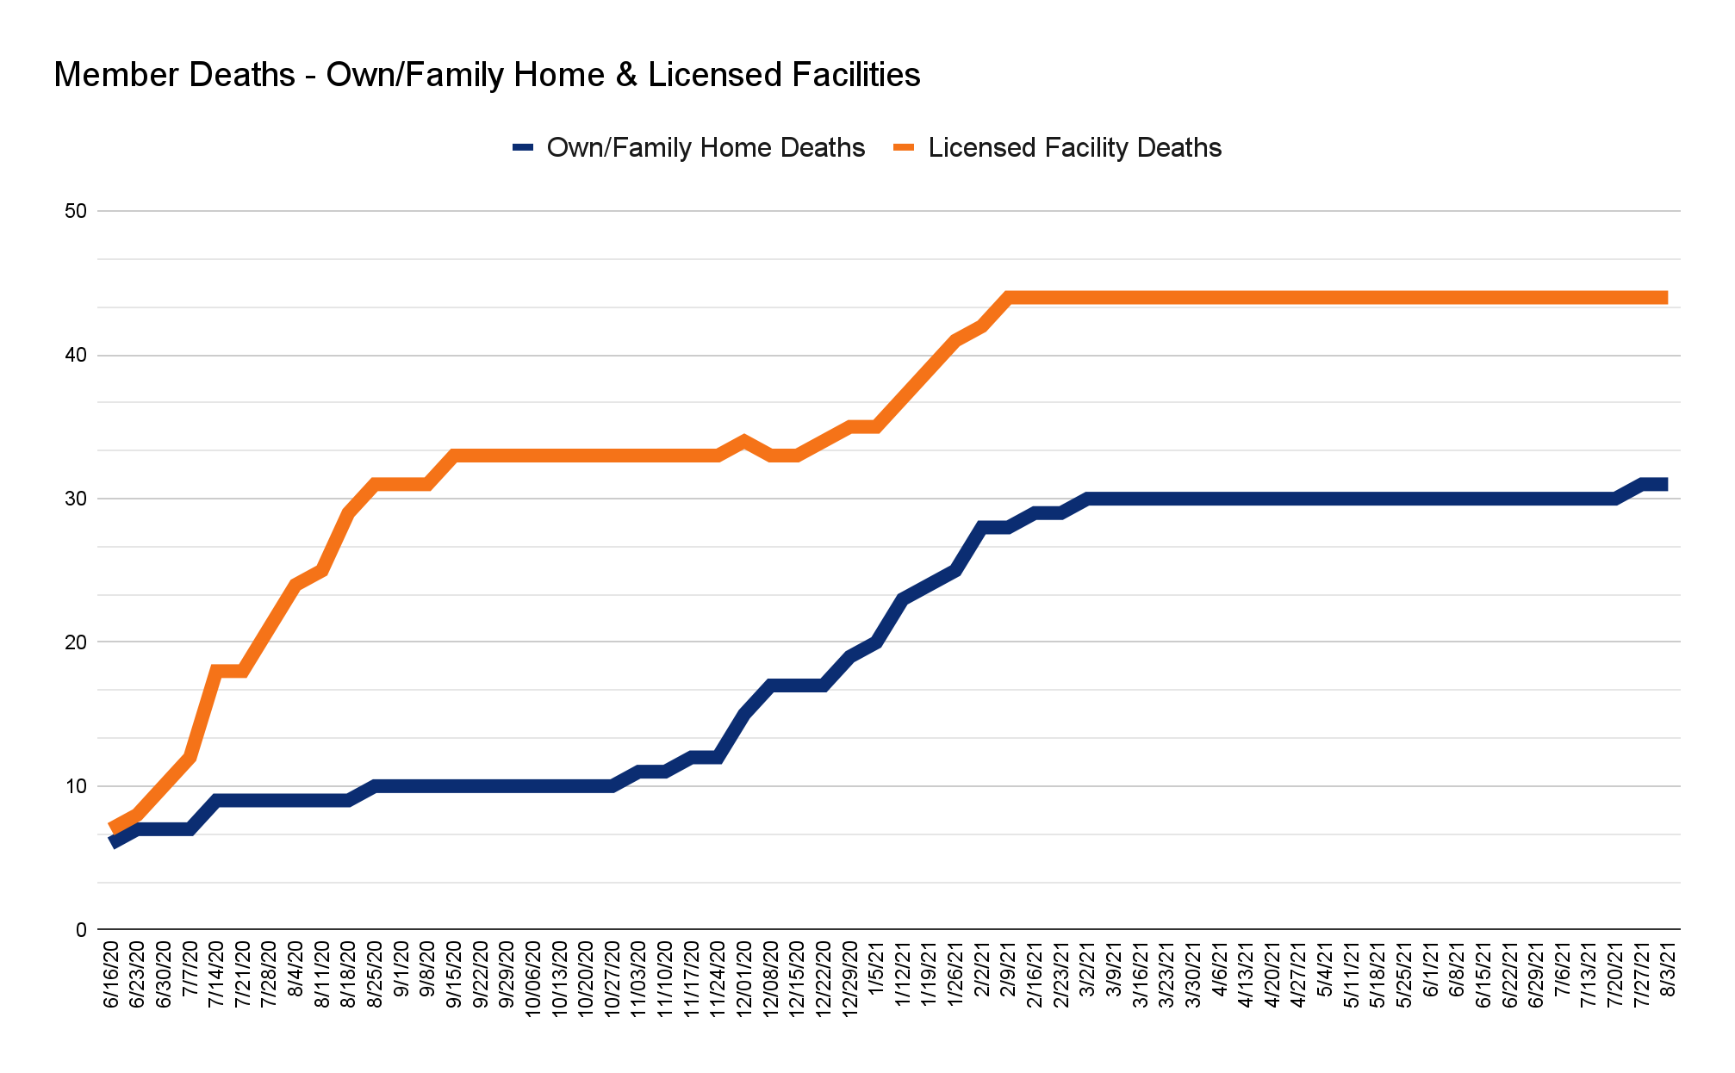
COVID-19 Member Mortality
Notes:
NICOLETTE:
Total: 75
Own Home: 31
Licensed Facility: 44

Slide 9
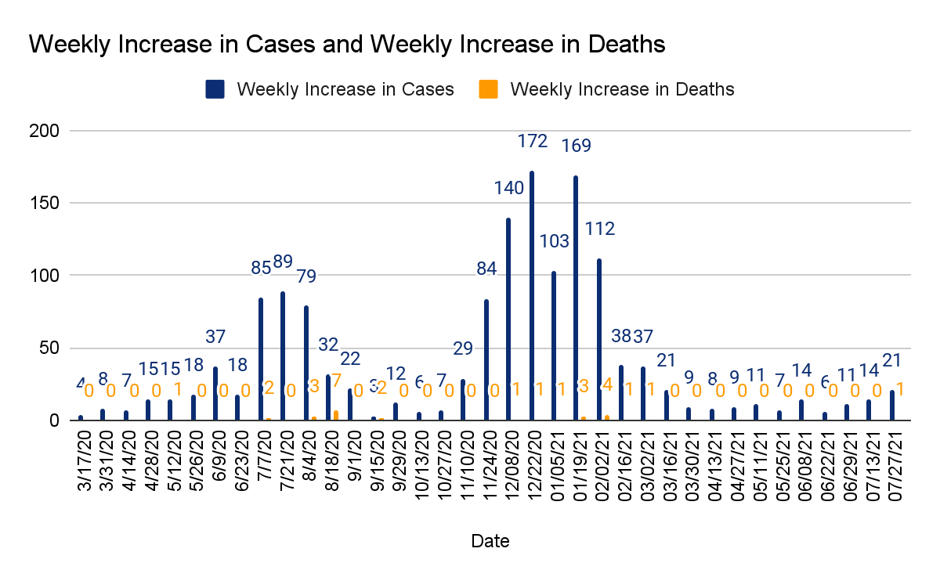
COVID-19 Member Positive Cases & Mortality
Notes:
NICOLETTE:
Week over week view of member positive cases-showing every other week to make the chart easier to read. The complete chart with all weeks is still available on the DDD Actions Related to COVID-19 webpage. Data for the reporting period ending August 3 included an additional 21 positive cases of COVID-19 among members and one member death.

Slide 10
COVID-19 Vaccine Distribution Update
Eligible Medicaid members can get non-emergency medical transportation (NEMT) to their vaccine appointment even if it is at a drive through site.
Contact your health insurance provider for more details.
AHCCCS Health Plan | How to Schedule NEMT
Banner University Family Care | 800-582-8686, Option 3 Hours: Mon.–Fri. 7:30 a.m.–5 p.m.
Banner University Family Care: Long Term Care | 833-318-4146, Option 3 Hours: Mon.–Fri. 7:30 a.m.–5 p.m.
Mercy Care | 1-800-624-3879 Hours: Mon.–Fri. 7 a.m.–6 p.m.
Mercy Care RBHA | 1-800-564-5465 Hours: Mon.–Fri. 7 a.m.–6 p.m.
United HealthCare | 1-888-700-6822 Hours: 24 hours a day, 7 days a week
AHCCCS Health Plan | How to Schedule NEMT
Care1st | 602-778-1800 or 1-866-560-4042 Hours: 24 hours a day, 7 days a week
Health Choice Arizona | 602-386-3447 or 1-800-322-8670 Hours: 24 hours a day, 7 days a week
Magellan Complete Care | 1-800-424-5891, Option 1 or 1-833-474-5060 Hours: Mon.–Fri. 8 a.m. –6 p.m.
Arizona Complete Health | 1-888-788-4408 Hours: Mon.–Fri. 8 a.m.–5 p.m.
Notes:
NICOLETTE:
Individuals eligible for Medicaid can get non-emergency medical transportation to their vaccine appointment by contacting their health plan. This chart shows the contact information for all Medicaid health plans in Arizona. Individuals who are unable to travel to a vaccination location, contact should contact their healthplan to request in home vaccination visits. If you need assistance, please call you support coordinator.

Slide 11
Updated Mask Guidance
CDC Updated Mask Guidelines on July 27, 2021
All people regardless of their vaccination status should wear a mask indoors in public in areas of substantial or high transmission.
https://covid.cdc.gov/covid-data-tracker/#county-view
Notes:
NICOLETTE:
The Arizona Legislature passed legislation during the latest legislative session that prevents mask mandates. Since then, on July 27, 2021, the Center for Disease Control and Prevention updated its guidance related to mask wearing. The CDC recommends that all people regardless of vaccination status wear a mask indoors in public in areas of substantial or high transmission. Currently all counties in Arizona are considered to have a substantial or high level of community transmission.
DDD continues to encourage all eligible people to get the COVID-19 vaccine and to follow CDC guidance for prevention further spread of COVID 19
DDD is updating its Congregate Care setting guidance document to incorporate the CDC’s updated recommendation.

Slide 12
Announcements
Provider Manual Chapter 64 - Preventing Member Abuse, Neglect and Exploitation
Person-Centered Planning Document
Qualified Vendor Agreement Public Comment Period
New Videos Available Online
Arizona Disability Voter Coalition (AzDVC)
Tuesday, August 17, 2021 from 9:00 a.m. to 11:00 a.m.
Attendees can join the meeting using https://zoom.us/j/94967382883
Notes:
NICOLETTE:
On July 14, 2021, the Division published the new Provider Policy Manual Chapter 64 - Preventing Member Abuse, Neglect and Exploitation. This policy requires Qualified Vendors providing residential or day services to train staff and offer training to members about the prevention of abuse, neglect and exploitation. All members living in licensed residential settings or attending day services should be offered this training annually. These vendors will be able to provide interested members a training schedule once they are ready to start training.
Support Coordinators will soon use a new process called Person-Centered Service Planning. This new process supports our mission of empowering individuals with developmental disabilities to lead self-directed, healthy and meaningful lives. It was created by AHCCCS and all Managed Care Organizations (MCO) supporting the Arizona Long Term Care System (ALTCS). The goal of the Person-Centered Service Planning process is to help the planning team to work together to create and put to action a plan driven by the member. Person-Centered Service Planning will help DDD ensure members’ voices and choices are heard. Members will have greater independence and input on the services they receive. Support Coordinators are being trained on the Person-Centered Service Plan and will begin using the new process once their training is complete.
As we have discussed on previous town halls, the Division is streamlining its contracting process for Qualified Vendors who provide Home and Community Based Services to members eligible for ALTCS. Part of this process is changes to the Qualified Vendor Agreement. On June 28, 2021, the Division posted updated documents for the entire proposed new Qualified Vendor Agreement for public review and comment. Instructions for submitting comments can be found on the website, bit.ly/dddrfqvareview. The public comment period will close on Friday, August 27, 2021. Your feedback is critical to this process. Please review these documents and provide feedback. This will help ensure DDD and its Qualified Vendors are providing the best services possible.
As part of the Division’s strategic planning, we have created new videos to introduce members and their families to DDD. They will help members and families better understand DDD. The topics are:
· Introduction to the Division of Developmental Disabilities
· Planning Meeting and Assessments
· Wants, Needs and Uncovered Services
· Learning New Skills
· What to Do When You Have a Complaint
· Filing an Appeal
· Introduction to Behavioral Health Services
More videos are being made to address additional topics. On the website you can select “Members & Families” from the menu on the left and then click the icon labeled “Informational Videos” to see these new videos.
AzDVC works to ensure Arizonans with disabilities have an opportunity to vote independently and with privacy and have full participation in the electoral process in registering to vote, casting a vote and accessing the polling sites. ASL and CART will be provided For more information, contact Renaldo Fowler at rfowler@azdisabilitylaw.org Meeting Agenda
Update on AzDVC activities:
An overview of Arizona’s new election law(s) Impact on Persons with Disabilities
Self Advocates Becoming Empowered
Project Development

Slide 13
Questions?
Notes:
Nicolette\Susan Rotundo Senior Project Manager
Hourly Nursing Assessment Tool (H-NAT)

Slide 14
Hourly Nursing Assessment Tool (H-NAT)
ARIZONA DEPARTMENT OF ECONOMIC SECURITY DIVISION OF DEVELOPMENTAL DISABILITIES

Slide 15
What is the H-NAT?
The H-NAT is the Hourly Nursing Assessment Tool.
The H-NAT is a tool that is used in conjunction with the existing Skilled Nursing Assessment form, to quantify in home skilled nursing services for DDD members. This tool includes skilled nursing services as well as modifiers that might impact skilled nursing services.
Sections of the H-NAT:
1) Skilled Nursing services: General, Neurological, Respiratory, Cardiovascular, Nutrition, Elimination, Skin Integrity, Medications,
2) Modifiers: Behavior, Communication, Training, PRN, Risk, Supplemental Nursing Assessment

Slide 16
Why was it developed?
The H-NAT was developed in response to concerns for consistency of skilled nursing care services provided to members across the state.

Slide 17
Who Developed the H-NAT?
The H-NAT was developed by a team of DDD nurses, nurse managers from Health Care Services, along with researchers from NAU UCEED. Pilots included nurses and district nurse managers. Support Coordinators were included in all discussions and phases of the project.
NAU researchers helped DDD gather information from other states who are approaching a similar concern and to be sure the H-NAT follows best practice.

Slide 18
How is H-NAT used?
Nurses will fill out the H-NAT using their knowledge of the member and the nursing assessment. The H-NAT compiles an estimate, and the nurses considers this estimate in amount of time provided for families.
Nurses will continue to collaborate with support coordination to determine appropriate time needed for the member.

Slide 19
What does the H-NAT mean for you?
The H-NAT will be used at initial planning meetings when it is determined that a member is requiring skilled nursing hours. It will also be used at each planning meeting as a tool assisting in determining skilled nursing estimates for DDD members who are provided with skilled nursing hours.
Notes:
If there is no change in the status, the tool

Slide 20
Does the H-NAT consider other family and home elements that may affect supporting the member in the home?
Yes! Through a supplemental nursing assessment piece of the H-NAT, elements such as the psychosocial and the home environment are considered, as part of the assessment process.

Slide 21
What is the benefit for members?
The H-NAT provides for consistent assessment of the member's needs and ensures members are receiving the skilled nursing care they require.

Slide 22
How can members and caregivers learn more about the H-NAT?
They can talk to the DDD District Nurse. The H-NAT is systematically and gradually being rolled out across Arizona. All district nurses are trained and can answer your questions.
Review the DDD Policy that guides the H-NAT Process
https://des.az.gov/sites/default/files/media/Division_Medical_Policy_Manual_Policy_1240-G_Home_Nursing_060921.pdf?time=1628121820466

Slide 23
Questions?
Notes:
Annette Lammon Belcher will address questions

Slide 24
DDD COVID Vaccination Statistics

Slide 25
DDD Vaccination Collaboration
DDD
Chief Medical Office and
Healthcare Services
DDD Support Coordination
AHCCCS
County HDs
DDD Population
ASIIS/DDD Database Tracking
Member Outreach
ADHS
DDD Health Plans
Notes:
County Health Departments
Arizona Department of Health Services
Arizona State Immunization Information System

Slide 26
DDD Population
17,112
< 12 Years of Age
45,790
DDD Membership Enrollment
As of July 15, 2021
28,678
≥ 12 Years of Age
Vaccine Eligible Population

Slide 27
DDD COVID Vaccine Eligible Population
25,575
LTC
50% (12,773) Vaccinated
Eligible for AHCCCS who met financial and medical requirements, are developmentally disabled, and have a medical need
28,678
≥ 12 Years of Age
Vaccine Eligible Population
1,980
Targeted Support
50% (983) Vaccinated
Enrolled in the AHCCCS Medical Benefits program, but are not eligible for ALTCS
1,123
DD Only SC
51% (575) Vaccinated
DDD provides support coordination for people who are DDD eligible, but do not qualify for the Arizona Long Term Care System (ALTCS)

Slide 28
DDD Current Vaccination Data 07/15/2021 All Eligible DDD Members
47%
Eligible DDD Population
Fully Vaccinated
6,983
First Dose
6,837
First Dose
Janssen/ J&J
Moderna Vaccine
Pfizer
Vaccine
6,367
Second Dose
6,090
Second Dose
1,062
Single Dose
Notes:
25-30% of our ENTIRE Population (including those ineligible for the vaccine)

Slide 29
DDD Survey Campaign
Priority for Initial Call Campaign
16,428
LTC
18,786
≥ 16 Years of Age
Vaccine Eligible DDD Population Identified with No Vaccine Doses Given
Call Campaign Initiated to Determine:
Homebound Status
Intent to Vaccinate
Transportation Needs to Vaccination Site
1,563
Targeted Support
794
DD Only SC

Slide 30
DDD Survey Campaign
20.1%
3,723
Self Reported First Dose
51.7%
8,681
Intend to Vaccinate
18,556
DDD
Members Contacted
1.1%
1.5%
276
Transportation Needed
203
Homebound
Notes:
Homebound Services were Statewide
We can still accommodate Homebound and Transportation needs

Slide 31
Continuing Topics
2nd Dose Abandonment
Vaccine Hesitancy
https://www.nationalacademies.org/news/2021/07/fighting-vaccine-hesitancy-what-can-we-learn-from-social-science
Approaches to improving both
Notes:
2nd dose abandonment is going down with Delta Variant

Slide 32
DDD Vaccination Activity
Questions?

